Slide 1


Asynchronous Coroutines with C#
Andrew Nosenko, software engineer Twitter, GitHub, StackOverflow: @noseratio

Slide 2
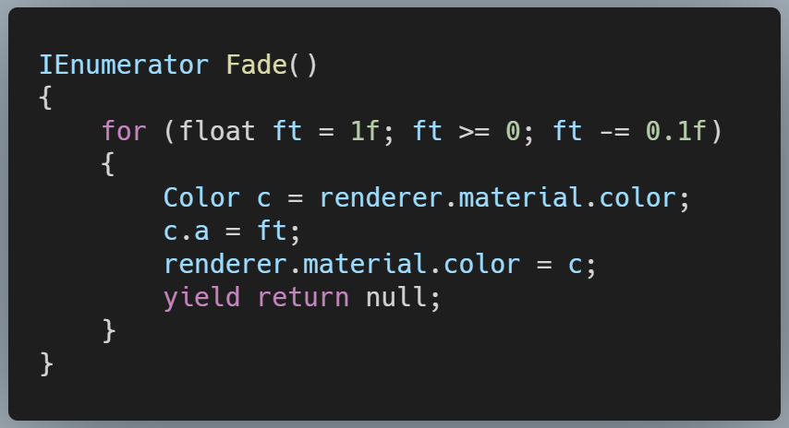

A simple C# method for rendering Fade Effect in Unit Game Engine

Slide 3

What are coroutines?
Coroutines are functions that can be can be suspended, resumed and executed cooperatively (often on the same thread).
This is how they are different from thread routines, which are typically preemptively multitasked.
Coroutines is an old and mature concept. Anyone remembers Windows 3.x Yield() method?
Nowadays coroutines easy to implement, thanks to the modern languages like C#, which takes excellent care of generating implicit state machine logic for our methods.

Slide 4
What are they useful for?
Coroutines are useful for script-like scenarios where the code execution flow can be suspended and resumed after each logical step.
We have explicit control over when to resume the execution after each step.
Many long-running background workflows can potentially be structured as a coroutines. For example, spell-checking, syntax highlighting, static code analysis.
One real-world example we'll try to cover later is automated UI Testing.

Slide 5

Coroutines without internal asynchrony
This approach has been in use since yield keyword was introduced in C# 2.0, allowing to implement state machines for IEnumerable or IEnumerator methods
Traditionally, we use yield return for synchronous generation of data sequences. With coroutines, we use it as a tool to break the code into multiple, individually executed steps
This technique has been popularized by frameworks like Unity Game Engine, Caliburn.Micro for WPF and others

Slide 6
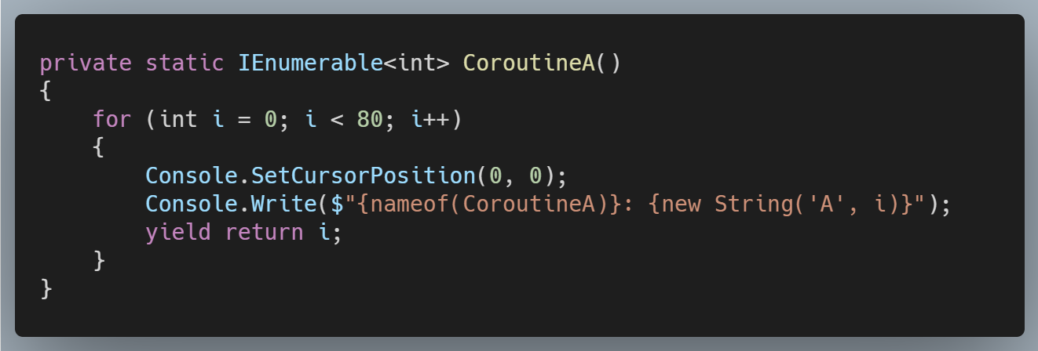
Example: Coroutine A as IEnumerable

Slide 7

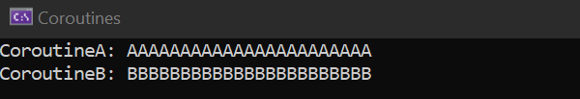
Coroutine B runs concurrently with A

Slide 8
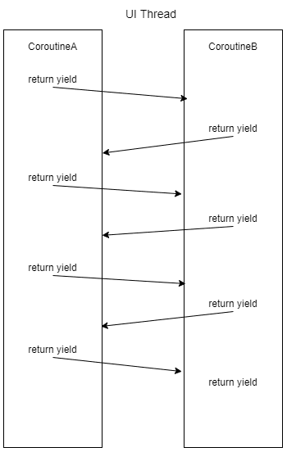
Coroutines A and B are executed concurrently on the main UI thread
The execution is driven by the code called coroutine driver, which:
• combines multiple INumerables into a single sequence
• executes it one step at a time by calling IEnumerator.MoveNext() upon timer interval

Slide 9
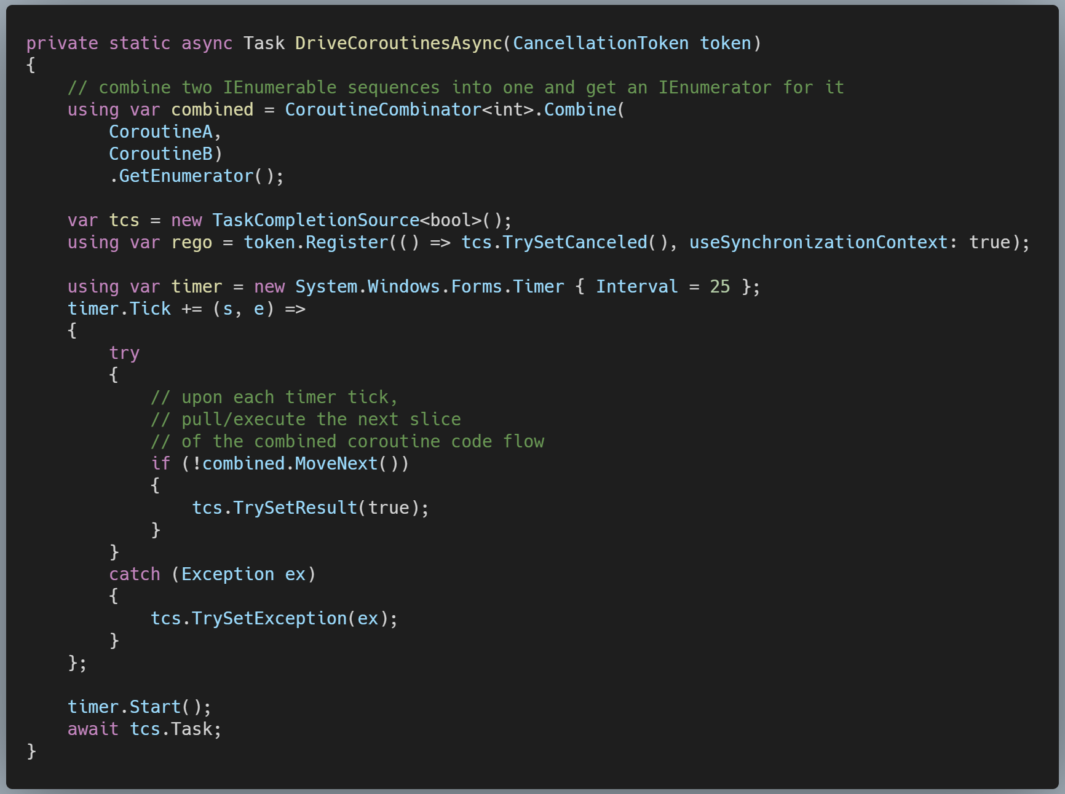
Coroutine driver

Slide 10
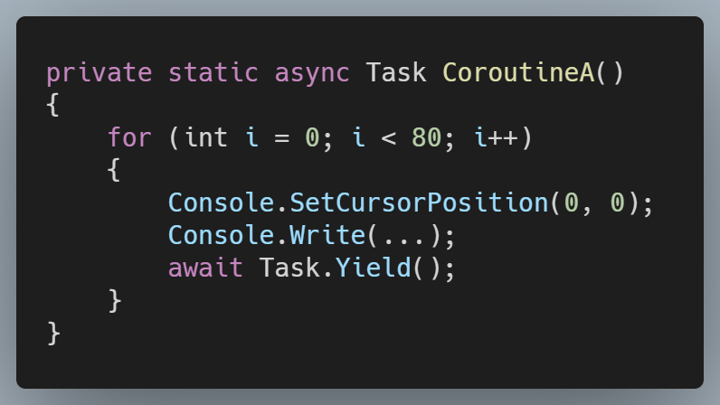
Why not simply use async/await ?
Instead of using IEnumerable and yield return, we might be tempted to use async/await:
However, we'd only be notified then about the completion of the whole method, not intermediate steps. We'd need to resort to a custom TaskScheduler, SynchronizationContext or awaitables for precise control over await continuations.

Slide 11

Coroutines with internal asynchrony
Ideally, we'd want to use async/await for awaiting the results of some actual asynchronous API, and yield return for suspending the execution flow.
It wasn't possible to combine these two until C# 8.0, but now we have language support for asynchronous iterators: • IAsyncEnumerable • IAsyncEnumerator • IAsyncDisposable • await foreach • await using

Slide 12
Coroutines with asynchrony
Let's reproduce what we've done so far with IEnumerable-based CoroutineA and CoroutineB, but using IAsyncEnumerable this time.
We still want to have a certain minimum time interval between yield return continuations.
To add some real asynchrony, let's say we want to proceed to the next step only when the UI thread is idle, and there is no pending user input in message queue.
We've made a special helper for that: await inputIdler.Yield()

Slide 13

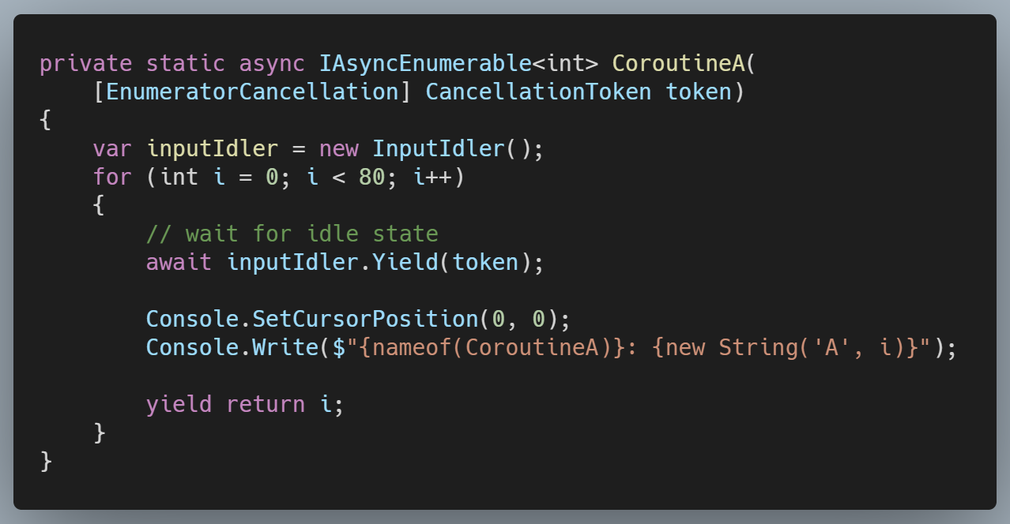
Async CoroutineA waiting for idle state

Slide 14
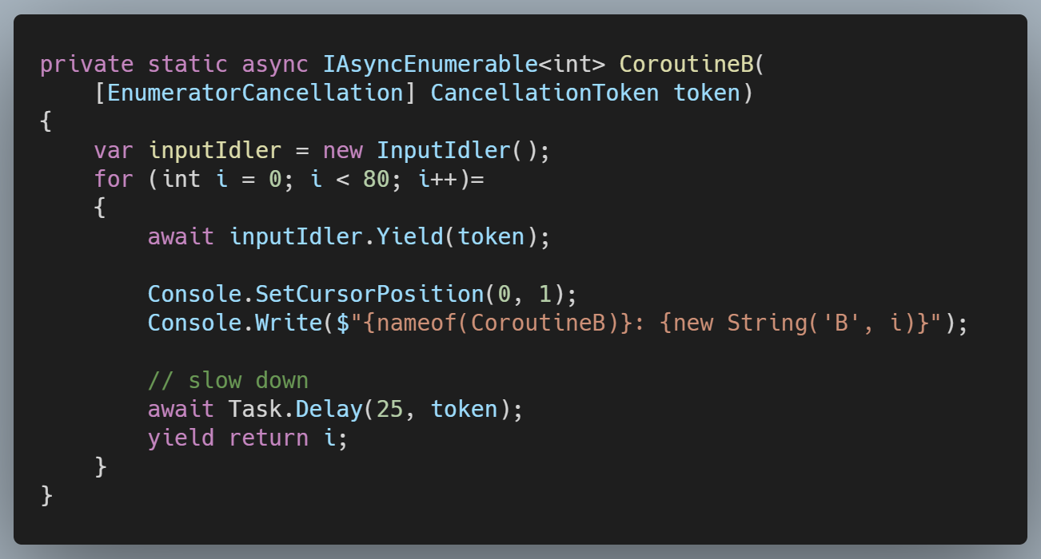

Asyn CoroutineB adds a delay
Let's also slow down CoroutineB by introducing an async Delay, for each step, just because now we can:

Slide 15
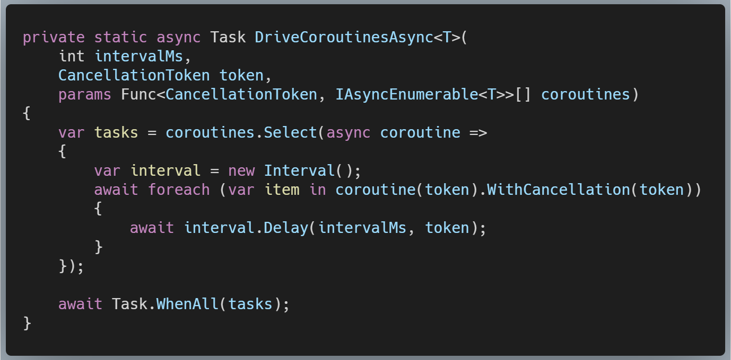

Asynchronous coroutine driver

Slide 16
Synchronizing async coroutines
We may say that coroutines A and B serve as producers to the coroutine driver code (the consumer), with both A and B run independently of each other.
But what if coroutines A and B need to synchronize their execution workflow upon each other? We can't just pass an IAsyncEnumerable for A into B, and vice versa.
For that, we use a special proxying helper AsyncCoroutineProxy. It which wraps the .NET Channel class to serve as asynchronous buffer for the progress notifications of each coroutine.

Slide 17
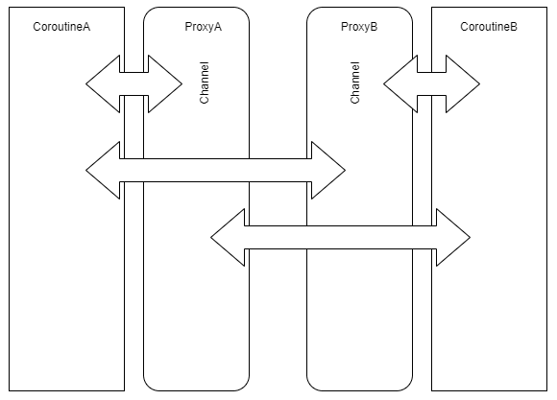
.NET Channel as asynchronous proxy
A Channel is like a pipe, we can push objects into one side of the pipe (with Channel.Writer.WriteAsync), and fetch them as an asynchronous stream from the other side (with Channel.Reader.ReadAllAsync).
Now, CoroutineA can await results from CoroutineB via ProxyB.
And vice versa, CoroutineB can await results of CoroutineA via ProxyA.

Slide 18

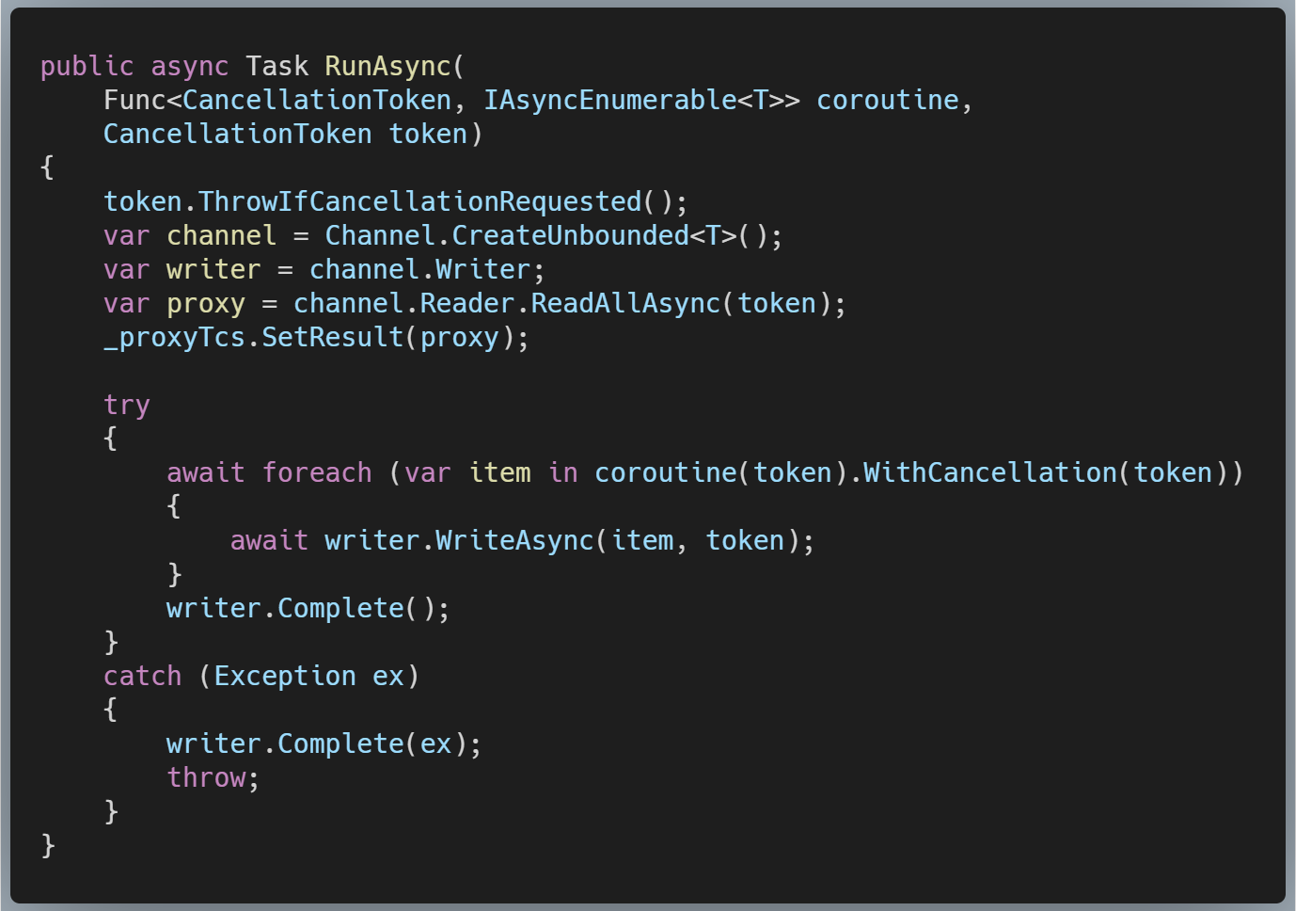
AsyncCoroutineProxy.RunAsync
We can use Async LINQ, too!

Slide 19
A real-world app testing using coroutines
With help of AsyncCoroutineProxy, CoroutineA and CoroutineB can operate as asynchronous producer/consumer to each other, and they can swap these roles.
That's actually how I use them for automated UI testing.
As a side project, I maintain a simple Windows Desktop app called DevComrade, for the purpose of for copy-paste productivity improvement. It uses SendInput API to simulate the paste operation of a plain text, character by character as though it was typed by a person. I needed to test that.

Slide 20
A real-world app testing, continued
For my test scenario, there's a foreground thread with a form containing a TextBox control, and a background thread that iteratively calls SendInput.
A decade ago, I'd probably use something like ManualResetEvent and blocking WaitOne() to synchronize these two threads at the key points of the test workflow.
Today, I can utilize asynchronous coroutines for that. BackgroundCoroutine and ForegroundCoroutine use yield return and await GetNextAsync() to synchronize as they are progressing. There is no blocking calls. Both coroutines are executed on different threads and actually run in parallel at times.

Slide 21


Automated UI testing demo
(if time allows)

Slide 22

Summing up
Asynchronous coroutines may help with structuring async workflows, including certain consumer/producer scenarios.
They are especially handy where there is no clear role separation between producer and consumer.
Similar problems can also be solved with mature frameworks like Ractive Extension or TPL Dataflow, but those might have a steep learning curve.
The concept can be used with other languages which support async iterators, including modern JavaScript.

Slide 23

References and resources
Coroutines - Wikipedia
Coroutines - Unity
IResult and Coroutines - Caliburn.Micro
Async/await as a replacement of coroutines - StackOverflow
Tutorial: Generate and consume async streams using C# 8.0 and .NET Core 3.0
Iterating with Async Enumerables in C# 8
C# events as asynchronous streams with ReactiveX or Channels

Slide 24


Code Samples
All code samples can be found here:
https://github.com/noseratio/coroutines-talk
DevComrade: The Copy/Paste Productivity Tool (uses coroutines for automated UI testing):
https://github.com/postprintum/devcomrade

Slide 25

Thanks for joining!
Special thanks to Sydney ALT.NET User Group: https://www.meetup.com/en-AU/Sydney-Alt-Net Feel free to follow up with any questions: @noseratio

